Slide 1

Physiological Consequences of Major Surgery
Evaluate the impact of general anesthesia, sternotomy, and thoracotomy on respiratory mechanics and gas exchange.
Understand the systemic inflammatory response and its implications for physiotherapy timing and intensity.
Review common post-operative complications, such as atelectasis, pleural effusion, and arrhythmias (AF).
Advanced Physiotherapist
Peter Chong

Slide 2
General Anaesthesia
Mechanism | Clinical Consequence
Loss of conscious respiratory drive | Dependence on mechanical ventilation intraoperatively; risk of apnoea on emergence from anaesthesia
Reduced functional residual capacity (FRC) - by 15 - 20% when supine | Airway closure occurs at higher lung volumes; increased V/Q mismatch and intrapulmonary shunting → hypoxaemia
Impairment of hypoxic pulmonary vasoconstriction (HPV) | Worsening intrapulmonary shunt; areas of atelectasis receive perfusion without ventilation
Ciliary suppression | Reduced mucociliary clearance → secretion retention → lobar collapse risk
Diaphragm dysfunction - altered phrenic nerve signalling | Paradoxical respiratory patterns; reduced tidal volume post-extubation
Residual neuromuscular blockade | Ventilatory muscle weakness; aspiration risk; atelectasis
Opioid analgesics (post-operatively) | Respiratory depression, reduced cough reflex, splinting due to pain - all impair secretion clearance

Slide 3
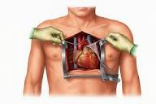
Sternotomy - Specific Respiratory Consequences
Chest wall splinting:
Post-operative pain causes patients to adopt shallow, rapid breathing patterns, reducing tidal volume and preventing effective coughing. This is the single most important physiotherapy target in the early post-operative period.
Reduced lung compliance:
Altering the pressure-volume relationship. Can impair gas flow and therefore mucociliary clearance
Phrenic nerve injury:
Occurs in up to 10–15% of cardiac surgical cases. Causes ipsilateral diaphragmatic palsy - a significant contributor to post-operative hypoxaemia and prolonged weaning.
Pleural breach:
Both pleural spaces are routinely entered during cardiac surgery; even if pleural drains are placed, residual effusions and pneumothorax risk persist and impair lung expansion.
Sternal instability (rare):
Presents as paradoxical chest wall movement, palpable 'click', and significantly impairs coughing and deep breathing. Requires surgical review and modification of physiotherapy techniques (avoid resistive breathing techniques; use hands-over-sternum support for all coughing).

Slide 4
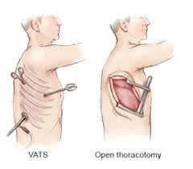
Thoracotomy - Specific Respiratory Consequences
Lateral thoracotomy (used for lung resection, transplantation, and oesophageal surgery) involves division of chest wall muscles and rib spreading, with distinct physiological consequences.
Intercostal nerve damage: thoracotomy causes direct trauma to intercostal nerves at the level of rib spreading. This produces significant post-operative pain and sensory loss, severely impairing the ability to take deep breaths and cough.
Muscle division: division of serratus anterior, latissimus dorsi, and intercostal muscles reduces the mechanical efficiency of the respiratory pump on the operative side.
Pneumothorax and pleural space management: post-thoracotomy chest drains are placed to evacuate air and blood. Drain management is critical to physiotherapy - malpositioned or blocked drains delay lung re-expansion.
Loss of lung tissue (post-resection): lobectomy or pneumonectomy reduces total lung parenchyma and requires significant adaptation of the remaining lung. Post-pneumonectomy, the contralateral lung must compensate for the entire gas exchange load.
VATS (Video-Assisted Thoracoscopic Surgery): compared to open thoracotomy, VATS is associated with less pain, fewer pulmonary complications, and faster physiotherapy progression - but does not eliminate the risk of atelectasis or secretion retention.

Slide 5
Physiological Consequences of Major Surgery
Impact on Respiratory Mechanics & Gas Exchange
Mechanism | Clinical Consequence | Physio Response
↓ FRC by 15–20% (supine) | Airway closure → V/Q mismatch → hypoxaemia | Upright positioning, deep breathing
Ciliary suppression (volatile agents) | ↓ Mucociliary clearance → secretion retention | ACBT, manual techniques
Diaphragm dysfunction | ↓ Tidal volume, paradoxical breathing | Respiratory muscle training
Residual neuromuscular block | Ventilatory weakness, aspiration risk | Spirometry, early extubation support
Pain analgesia | Respiratory depression, reduced cough reflex | Pain optimisation; supported coughing
Phrenic nerve injury (CABG) | Ipsilateral diaphragmatic palsy → hypoxaemia | Positioning, non-invasive ventilation
Pleural breach (sternotomy/thoracotomy) | Effusion, pneumothorax risk | Auscultate, CXR, Monitor drains; targeted expansion

Slide 6
2.2 Systemic Inflammatory Response and Implications for Physiotherapy
Major surgery - particularly cardiac surgery with cardiopulmonary bypass (CPB/ blood pumping machine) - activates a profound systemic inflammatory response syndrome (SIRS), which has direct implications for physiotherapy timing and intensity
Pathophysiology of SIRS Post-Cardiac Surgery
CPB exposes blood to non-endothelialised circuit surfaces, activating complement, neutrophils, platelets, and the coagulation cascade. This generates a 'whole-body' inflammatory state.
Cytokine surge peaks within 2–4 hours post-CPB and can persist for 24–72 hours. Consequences include capillary leak, oedema, myocardial depression, and multi-organ dysfunction in severe cases.
Reperfusion injury: restoration of coronary blood flow after ischaemia generates reactive oxygen species (ROS), contributing to myocardial stunning, endothelial damage, and systemic inflammation.
Coagulopathy (clotting issues or DVT) is near-universal post-CPB - heparinisation, haemodilution, and platelet dysfunction all contribute. Chest drain losses must be closely monitored.

Slide 7
Physiotherapy Implications
The inflammatory response typically resolves by 48–72 hours post-operatively in uncomplicated cases. This is the key window where physiotherapy should shift from low-intensity supportive care (positioning, passive exercises, breathing techniques) to active mobilisation.
Progressing too early (within the first 12–24 hours in a haemodynamically unstable patient) risks cardiovascular compromise; delaying beyond 48–72 hours risks deconditioning, atelectasis, and prolonged ICU admission.
SIRS Feature | Physiotherapy Consideration
Myocardial stunning - reduced cardiac output | Strict haemodynamic monitoring during any activity; low-intensity early mobilisation; avoid isometric exercises
Capillary leak / fluid shifts - third-spacing | Significant oedema may impair range of motion and comfort; respiratory muscle function may be compromised
Coagulopathy - drain losses | Confirm coagulation status before invasive physiotherapy (e.g., manual techniques over wound sites); ensure drain patency. What is their INR levels
Fever / pyrexia | Pyrexia increases metabolic demand - increased VO2 and VCO2. High fever (>38.5°C) should prompt medical review before active exercise
Delirium / reduced consciousness | SIRS contributes to cerebral hypoperfusion and ICU delirium. Assess cognitive status before exercise; prioritise orientation and communication
Pulmonary inflammation - increased alveolar permeability | ARDS risk in severe cases. Monitor for worsening P:F ratio, CXR changes. Early positioning (semi-recumbent) and secretion management remain priorities

Slide 8
2.3 Common Post-Operative Complications Relevant to Physiotherapy
Atelectasis
Partial or complete collapse of the alveoli
Most common post-operative pulmonary complication, occurring in up to 70–80% of cardiac surgical patients to some degree.
Mechanism: airway closure below FRC (due to anaesthesia, pain, diaphragmatic dysfunction, and increased closing volume), secretion plugging, and compression from pleural effusion.
Radiographic findings: basal linear opacities, elevated hemidiaphragm, mediastinal shift towards the collapse.
Physiotherapy is the primary treatment:
ACBT, incentive spirometry, positioning (sitting upright, lateral positioning towards the unaffected lung), and supported coughing.
Severe lobar collapse may require suction if secretion plugging is severe - this is a medical decision, but the physiotherapist's assessment is critical in identifying those who are failing to respond.

Slide 9
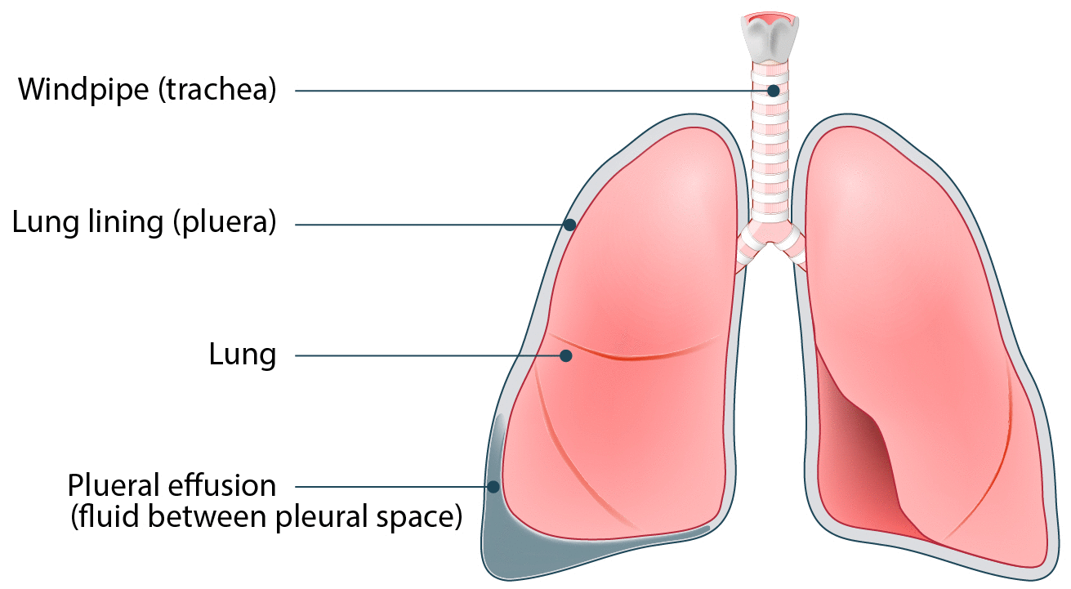
Pleural Effusion
An abnormal build-up of fluid between your lungs and chest wall (Pleura)
Near-universal post-cardiac surgery, particularly left-sided following CABG (from pleural breach and pericardial fluid).
Small effusions resolve spontaneously and do not require physiotherapy modification. Significant effusions (compromising lung expansion, producing dyspnoea, or causing mediastinal shift) require drainage.
Physiotherapy role:
Positioning to optimise drainage and ventilation to non-effused areas; avoid placing the patient in side-lying with the effusion-side down if it causes significant hypoxaemia.
Post-thoracentesis or drain insertion: monitor for pneumothorax; re-assess breath sounds and encourage deep breathing to re-expand the lung.
Liaise with medical team to confirm appropriate plans for pleural effusion

Slide 10
Atrial Fibrillation (AF)
Rapid irregular heart beat
The most common arrhythmia post-cardiac surgery, occurring in 20–40% of CABG patients and up to 60% of valve surgery patients. Peak incidence is Day 2–3 post-operatively.
Mechanism: surgical trauma to atrial tissue, pericardial inflammation, autonomic imbalance, electrolyte disturbances (hypokalaemia, hypomagnesaemia), and adrenergic surge all contribute.
Physiotherapy implications:
New AF requires prompt medical notification. Assess rate ventricular rates >110 bpm at rest significantly reduce cardiac output and exercise tolerance. Do not commence or continue active mobilisation during uncontrolled rapid AF.
Haemodynamically stable AF (controlled rate, no hypotension) does not necessarily preclude mobilisation - discuss with the medical team and use close monitoring.
AF increases stroke risk significantly: ensure anticoagulation is commenced or confirmed before any vigorous activity.

Slide 11
Hospital Acquired Pneumonia
Pneumonia after surgery (post-operative pneumonia) is a serious, often hospital-acquired infection occurring when bacteria infects the lungs, frequently due to reduced breathing, immobility, or intubation
Key Causes and Risk Factors
Anesthesia/Sedation: Affects the ability to breathe deeply and clear mucus from the lungs.
Immobility: Bed rest leads to fluid accumulation in the lungs.
Intubation: Ventilation during surgery raises the risk of bacteria entering the lungs.
Pain: Pain from the surgical site may limit deep breathing or coughing.
Prevention
Incentive Spirometry: Using a device to encourage deep breathing.
Early Movement: Walking or moving around as soon as permitted.
Deep Breathing/Coughing Exercises: Taking deep breaths and coughing frequently (using a pillow to support the abdomen, known as splinting).
Positioning: improved FRC and therefore mucociliary clearance

Slide 12
Deep Vein Thrombosis:
A blood clot that forms in a deep vein, usually the leg or pelvis. If left untreated can lead to seriously life-threatening pulmonary embolism (PE)
Symptoms to Watch For:
Pain, swelling, or tenderness in one leg (usually the calf).
Redness or discolouration of the skin.
Veins that are hard or warm to the touch.
Chest pain, breathlessness, or collapse, seek emergency care immediately
Preventive Measures
Early Mobilization: Getting up and walking as soon as possible after surgery.
Ankle Pumps: ankles up and down, mobilising
Compression Stockings: Elastic stockings to improve circulation.
Medication: Blood thinners (e.g., heparin) to prevent clotting.
Mechanical Devices: Devices that squeeze the legs to encourage blood flow.
Hydration: Maintaining good fluid intake.

